Slide 1
NYC Flight Data – Data Analytics with Python Project Report
By Anupam Ranjan

Slide 2
Agenda
About the Project
Dataset description
Business questions identified
Hidden insights of the dataset

Slide 3
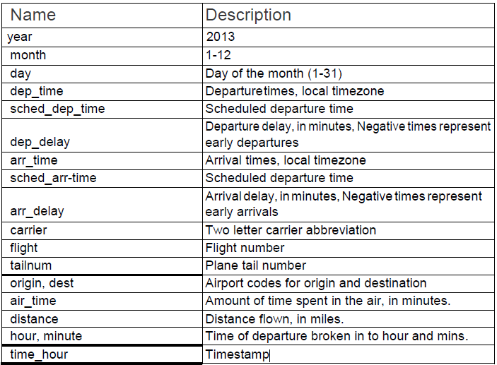
NYC Flight Data – Project Description
Dataset Attributes
The Dataset
This dataset contains information about all flights that departed from NYC (e.g. EWR, JFK and LGA) in 2013: 336,776 flights in total
The objective is perform exploratory data analysis (EDA) to find hidden insides of the dataset

Slide 4
NYC Flight Data – Business Questions to be addressed
Airport Performance
What is the concentration of Carriers at the origin airports?
Which are the best airports for on-time arrival of flights?
Which is the Best Airport for on-time departure?
Which month are have the least airline traffic?
What is the hourly traffic of flights?
Carrier Performance
Which are the 5 best airlines in terms of arrival delays?
Which airlines has fastest and slowest speed?
Flight Delays
What is the pattern of delay of short, medium and long distance flights?
What is the average departure delay of each airline at Origin?
Which flights are delayed by more than 30 minutes?
On average how do delays of flights vary over the day?
Sector Performance
Which sectors are the most busy and which are least busy?
Is there a relation between flight delays and sectors congestion?

Slide 5
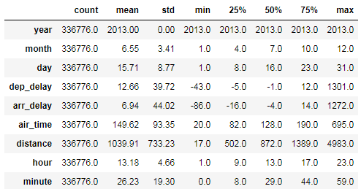
NYC Flight Data – Description of the dataset?
The dataset had 336776 rows. There were considerable NaN values
Departure and Arrival Delay seems to have some outliers as the Max value to too large
Distance seem to take some discrete values

Slide 6
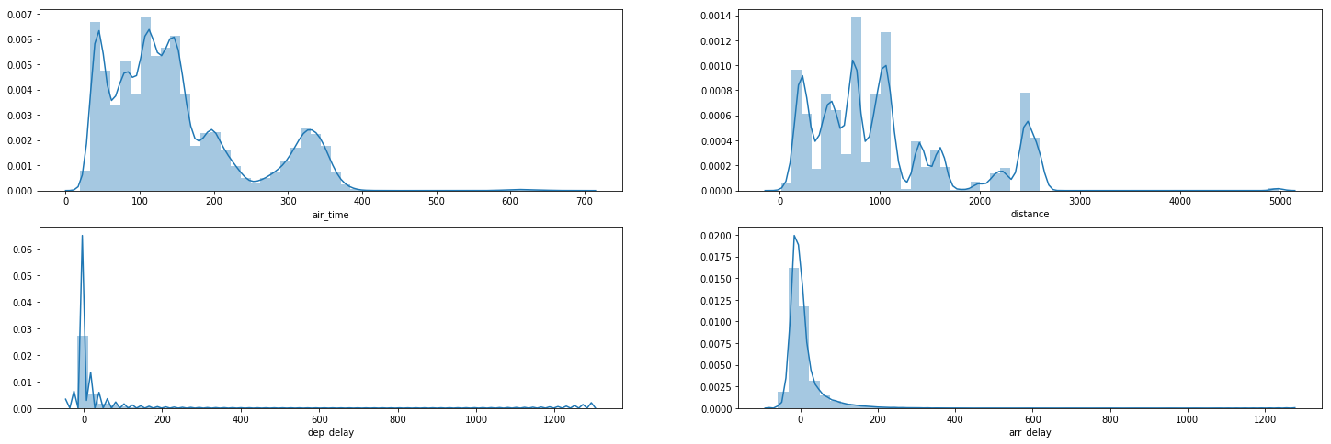
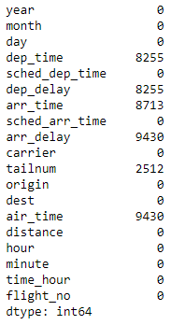
Air Quality – How good is the quality of data collected?
Missing Values
air time, distance: There seems to be lot of randomness in the distribution of data. The distance data takes discrete values
Departure Delay: it takes a sudden peak value between 0 - 20 minutes and then tapers down. There are apparent outliers in the dataset
Arrival Delay: It follows somewhat normal distribution with high kurtosis and +ve skewness

Slide 7
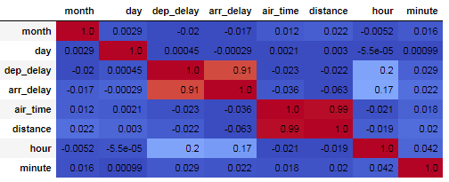
Air Quality – How good is the quality of data collected?
Arrival Delay and Departure Delay are +vely correlated
Distance and air time have high degree of correlation.
Arrival delay and distance need to be dropped for machine learning algorithm implementation

Slide 8
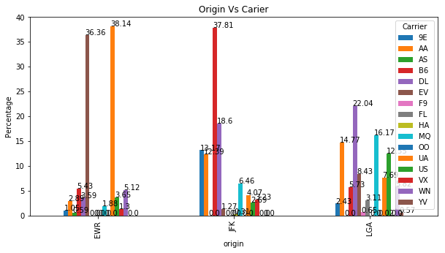
Airport Performance: Concentration of Carriers at the origin airports?
LGA seems to have much more equal distribution of carrier than EWR and JFK. At least 7 carrier have 5% share in total flights
JFK seem to have high number of B6 carrier(38%) and 4 other airlines have more than 5% share
EWR seem to have high concentration of 2 carrier - YV(36%) and UA(38%). It has over reliance on these2 carriers

Slide 9
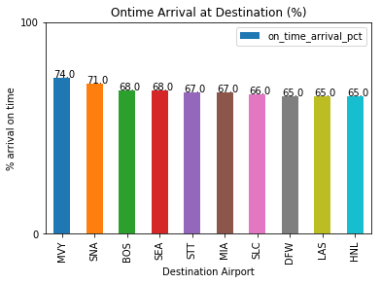
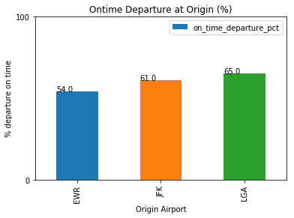
Airport Performance: Best airports for on-time arrival & departure of flights?
MVY and SNA leads from other airports in terms of on time arrival with a 69% on-time flights
However, there is not significant gap between the next 5-6 airports(SEA, MIA, STT, BOS, DFW, SLC, HNL, LAS) which range between 64% to 67%
LGA is the best on time departure airport with a score of 65%

Slide 10
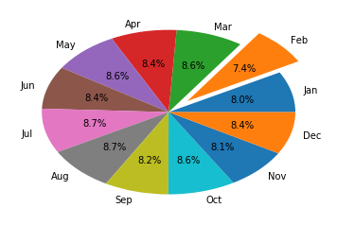
Airport Performance: Which month are have the least airline traffic?
Feb is the most lean month in terms of air traffic.
Air traffic is evenly distributed in the remaining months with 8-9 percent in each month
Hence, if any planned maintenance is to be done, February should be a preferred choice

Slide 11
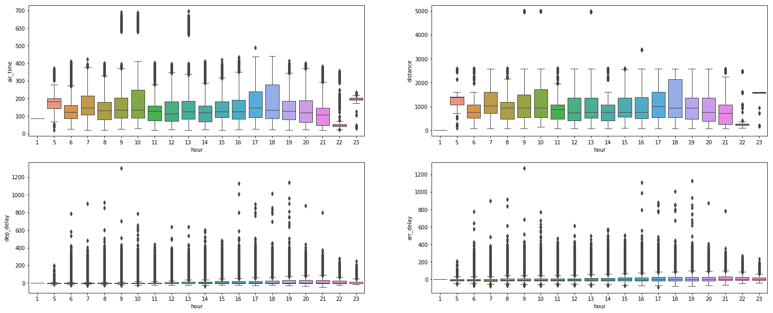
Airport Performance: What is the hourly traffic of flights?
longer flight tend to be between 7 am to 10 am and again between 5 pm to 6 pm

Slide 12
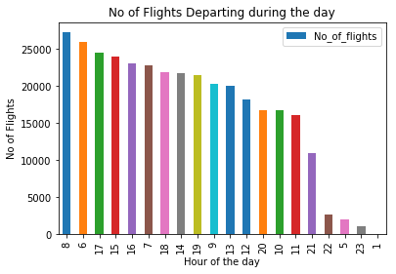
Carrier Performance: What is the hourly traffic of flights?
The peak time traffic is in the time zone 8:00-9:00, 6:00-7:00, 17:00-18:00, 15:00-16:00 and 16:00-17:00 region
There are no flights scheduled between 2:00-4:00 am
Other lean period of the day are 23:00-24:00, 5:00-6:00 and 22:00-23:00. Any high priority maintenance can be planned in lean hours

Slide 13
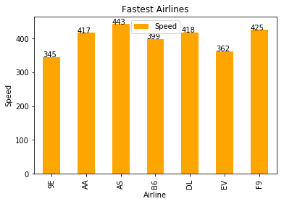
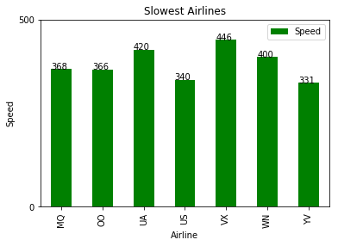
Carrier Performance : Which airlines has fastest and slowest speed?
AS airline is the fastest with 443 MPH of average speed. The next 6 fastest airlines are F9, DL, AA and B6 whose average speed is in the range of 399 to 425 MPH
YV is the slowest airline with an average speed of 331 MPH.

Slide 14
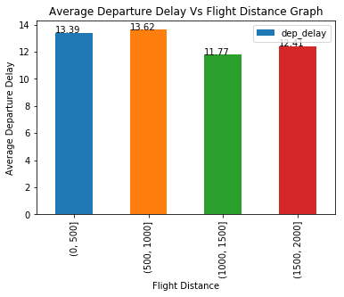
Flight Delays: Pattern of delay of short, medium and long distance flights?
The departure delay of medium distance flights (1000 - 1500 miles) is the lowest (11.77 minutes)
The departure delay of short distance flights (500 - 1000 miles) is the highest (13.62 minutes)
The delays are higher in short distance flights (< 1000 miles) than is long distance flights (>1000 miles)

Slide 15
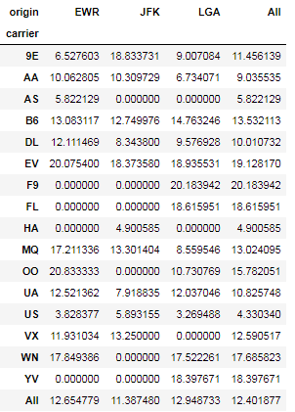
Flight Delays: What is the average departure delay of each airline at Origin?
LGA has highest mean departure delay of 12.948 minutes across all flights while JFK has least mean departure delay
Carrier F9 has the highest average departure delay of 20.18 minutes
US airlines has least average departure delay of 4.33 minutes
Best airlines at respective airports
EWR: US airlines – 3.82 minutes
JFK: HA airlines – 4.9 minutes
LGA: AA airlines – 6.73 minutes

Slide 16
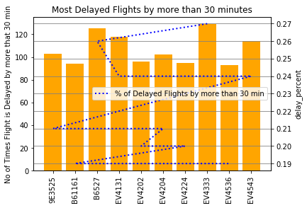
Flight Delays: Which flights are delayed by more than 30 minutes?
EV4333 has the maximum no of flights delayed – 130 flights or 27%
Flight B6527 comes next which is delayed approx 127 times or 26%
Below is the list of other 8 airlines that had maximum frequency of delays:
EV4131 - 122 times or 26%
EV4543 – 117 times or 26%
9E3525 – 103 times or 25.3%
EV4204 – 103 time or 25.3%
EV4202 – 98 times or 25%
EV4224 – 97 times or 24.8%
EV4536 – 96 times or 24.5%
B61161 – 97 times or 24.8%

Slide 17
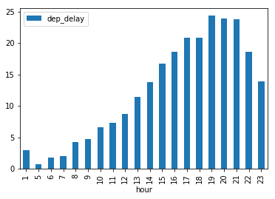
Flight Delays: How do delays of flights vary over the day?
The departure delay tend to be longer as the day progresses. They peak during 17:00 - 22:00 hours to more than 17 minutes
Morning flights (6 am to 9 am) have east amount of departure delays (2-5 minutes)

Slide 18
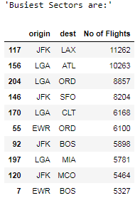
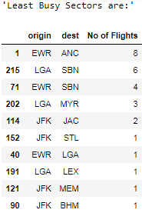
Sector Performance: Which sectors are the most busy and which are least busy?
JFK - LAX and LGA - ATL are the two busiest sectors with more than 10,000 flight operating in each sector
LGA - ORD, JFK - SFO, LGA - CLT and EWR - ORD are next busiest sectors with flights operating between 8857 to 6100 respectively
JFK - STL, JFK - LGA, LGA - LEX, JFK - MEM and JFK - BHM are the least popular sectors with just 1 fight operating in the entire year
Other least operating sectors are JFK - JAC, LGA - MYR, EWR - SBN, LGA - SBN and EWR - ANC with less that 10 flights

Slide 19
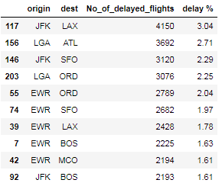
Is there a relation between flight delays and sectors congestion?
Top 10 sectors with highest flight delays
JFK LAX sector has maximum number of delayed flights (4105) which account for 3.04% of all the flights that are delayed
LGA ATL, JFK SFO, LGA ORD and EWR ORD, each of these sectors have very high number of delayed flights and each of them account for more than 2% of overall delayed flights
Relation between Flight Delays and Sectors
We observe complete correlation between no of flights operating in the sectors and highest flight delays in those sectors.
It is clear that reason for flight delays is primarily the congestion of the sectors – higher the flights, higher the % of flights getting delayed in those sectors

Slide 20
Thank You

